Slide 1
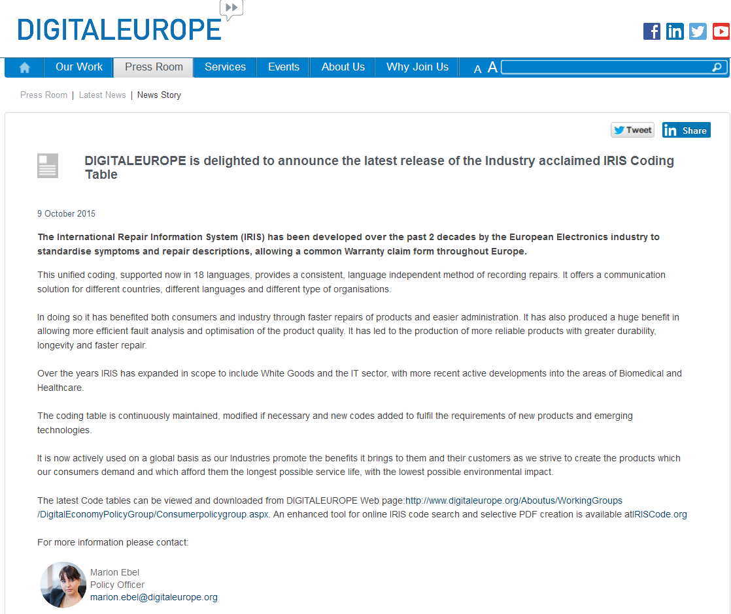
http://www.digitaleurope.org/Pressroom/LatestNews/NewsStory.aspx?newsID=397

